Slide 1
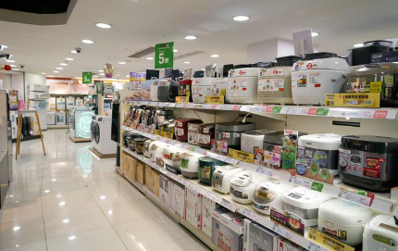
RETAIL SALES DATA ANALYSIS PROJECT
USING PYTHON FOR INSIGHT AND VISUALIZATION.
BY
EDESIRI EFETOBOR
NOVEMBER 15TH ,2024.

Slide 2
INTRODUCTION TO THE DATA
Key columns.:
Sales Revenue (USD): Total revenue generated from sales.
Units Sold: Quantity of items sold.
Discount Percentage: The percentage discount applied to products.
Marketing Spend (USD): Budget allocated to marketing efforts.
Store ID: Identifier for the retail store.
Product Category: The category to which the product belongs (e.g., Electronics, Clothing).
Date: The date when the sale occurred.
Store Location: Geographic location of the store.
Day of the Week: Day when the sale took place.
Holiday Effect: Indicator of whether the sale happened during a holiday period.
OVERVIEW OF THE DATASET
DATA SOURCE:
https://www.kaggle.com/datasets/abdullah0a/retail-sales-data-with-seasonal-trends-and-marketing/data

Slide 3
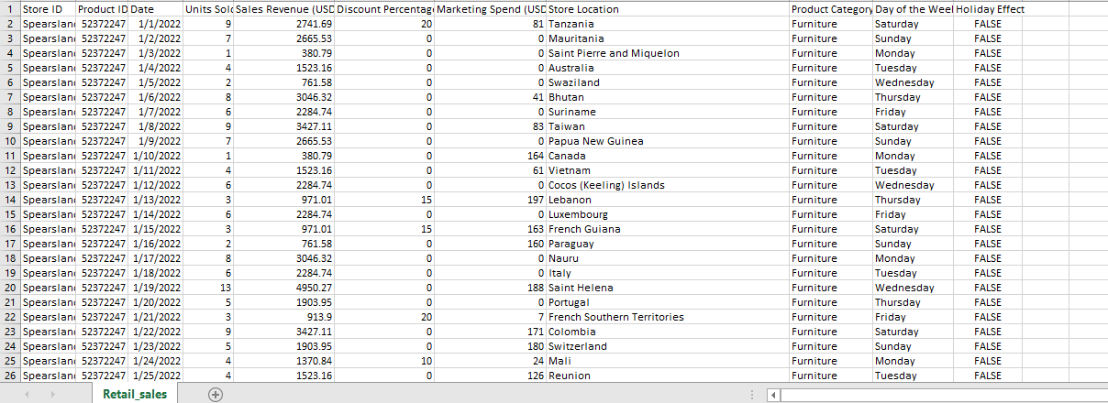
RETAIL DATASET Rows-3000 Columns-11

Slide 4
KEY QUESTIONS
What are the total and average sales?
Find the total of product category.
Calculate the monthly and yearly sales.
What are the top 20 stores with the most revenue?
Stores that spent on marketing across all product.
What are the top store locations in terms of total revenue according to the product categories?
What is the effect of holiday on sales?
Top products with the most revenue count with discount availability.
Analyze market spend based on the product category.

Slide 5
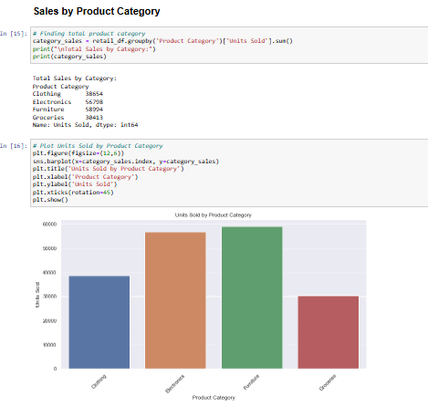
EXPLORATORY DATA ANALYSIS

Slide 6
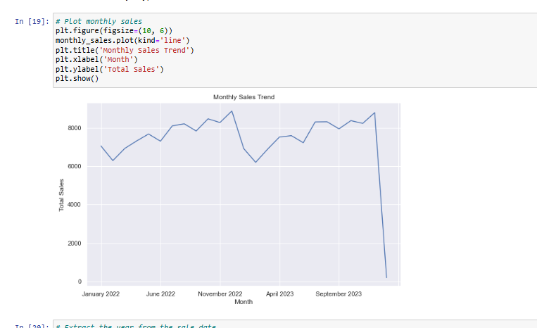

Slide 7
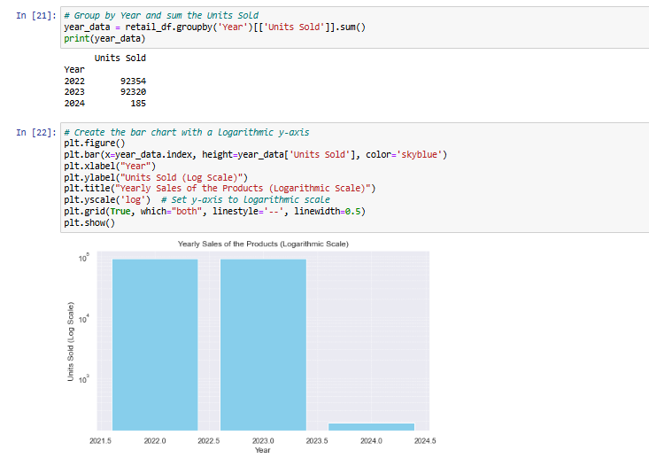

Slide 8
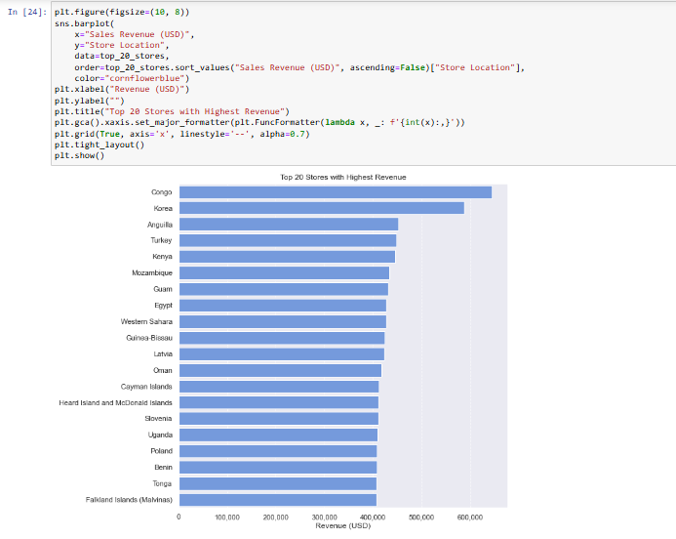

Slide 9
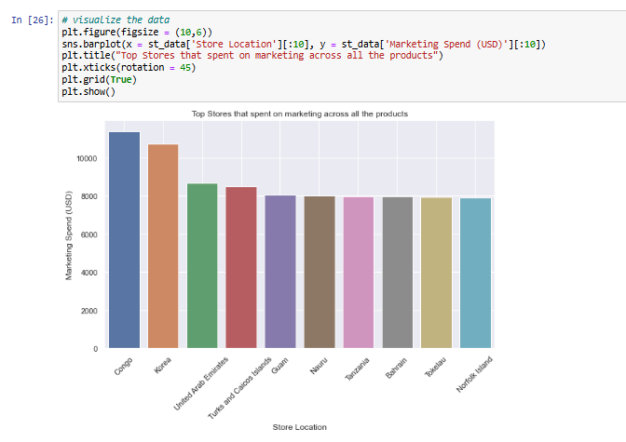

Slide 10
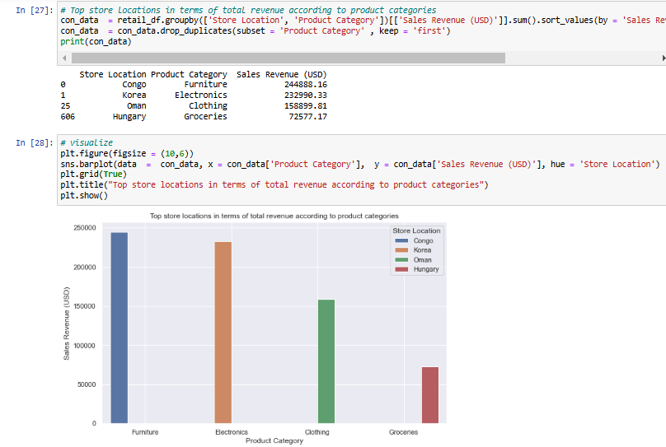

Slide 11
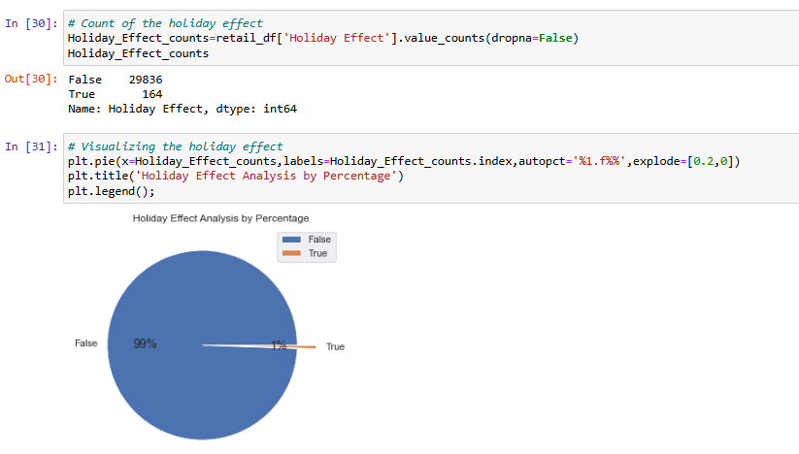

Slide 12
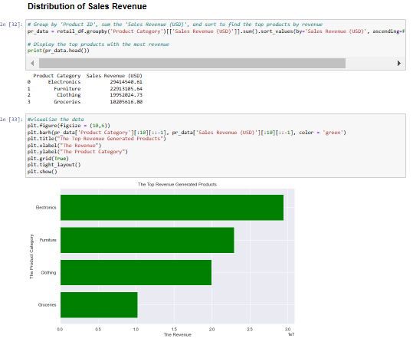

Slide 13
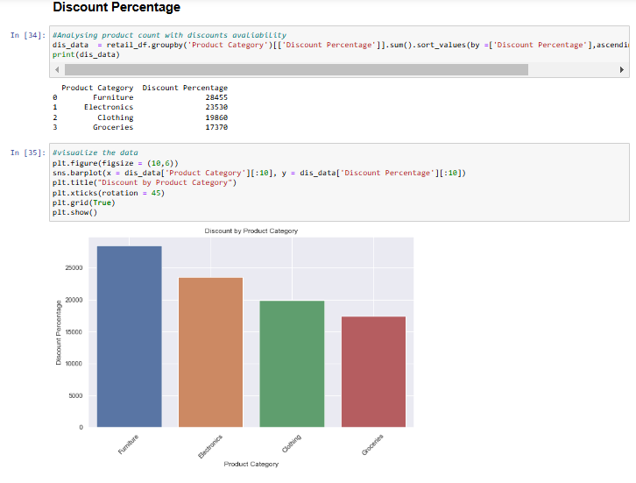

Slide 14
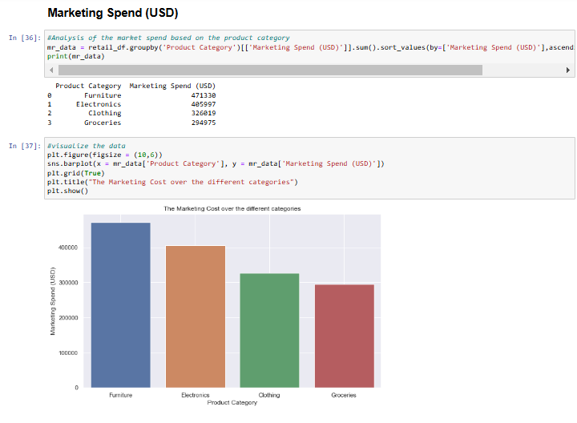

Slide 15
CONCLUSION: OBSERVATION
We can see from the analysis that sales by product Category has the highest sales of 58,944units was sold, which is 31.9% of the total sales(184,859). Monthly and Yearly sales: from the monthly sales December 2022 is the month with the highest sales of 8,878units and the least is January 2024 with 185 units sold. Year 2022 is the year with the highest sales of units (92,354), just a bit higher than year 2023 where 92,320units were sold. Year 2024 is the year with the least sales of 185units Store location: We can observe from our data analysis that the store in Congo performed best in terms of highest sales revenue of 644.103.38(USD) and you can see that they spent on marketing which cost 11,387(USD). Holiday effect: The holidays did not have any effect on sales because from the analysis it is 99% false. This shows that sales was still going on. Distribution of sales revenue: From the product category, electronics generated the most revenue of 29,414,540.61(USD). Discount availabilty: Furniture is the product with the most discount percentage and there was an increase in the volume of units sold. Marketing Spending: We can observe from the chart that furniture has the chart that furniture has the highest marketing spend(promotional and advertising efforts).

Slide 16
RECOMMENDATION
Based on these findings I would suggest that:
Invest more in high performing product categories while the focus on less profitable ones. Allocate resources differently for high revenue locations compared to under performing ones, perhaps by running targeted marketing drive. Also, I will recommend increase in marketing spend before high performing periods e.g. holidays or weekends and decrease it during low sales periods as this will result in more sales and cause an increase in revenue.

